Slide 1

Google Data Analytics Capstone Project
Presented by:- Maninder Singh
Email:- manindersingh.camp@gmail.com

Slide 2
Cyclistic is a Chicago bike-share company that launched in 2016. They offer 5,824 bicycles that can be picked up and dropped off at any of their 692 stations across Chicago. Their large offering of bikes also offers some variety: standard two-wheeled bikes, reclining bikes, hand tricycles, and cargo bikes.
In order to appeal to a large customer base, Cyclistic offers multiple pricing plans: single-ride passes, full-day passes, and annual memberships. Customers who purchase annual memberships are considered ‘Cyclistic Members’, while those purchasing single and day passes are considered ‘Casual’.
Introduction

Slide 3
I am a junior data analyst working in the marketing analyst team at Cyclistic. Lily Moreno, the director of marketing believes the company’s success depends on maximizing the number of annual memberships, and has tasked us with discovering insights into how to convert casual riders into Cyclistic Members.
Analyze historical data to determine how casual riders and Cyclistic Members use the service differently, and offer recommendations on how to convert casual riders into Cyclistic Members.
The Scenario

Slide 4
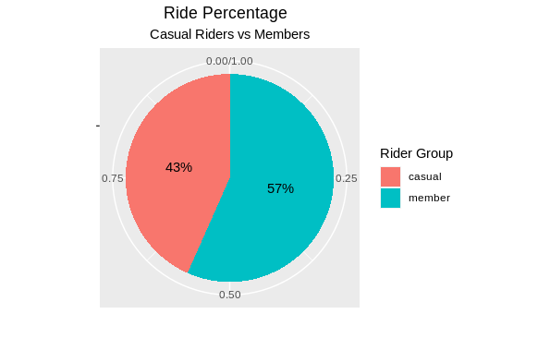
To begin our analysis, we will begin with a simple comparison of casual rides vs. member rides.
A simple comparison of total rides between the two rider groups shows a significant portion (~57%) of the rides taken in 2021 were by riders with Annual Memberships.
Analysis and Visualization

Slide 5
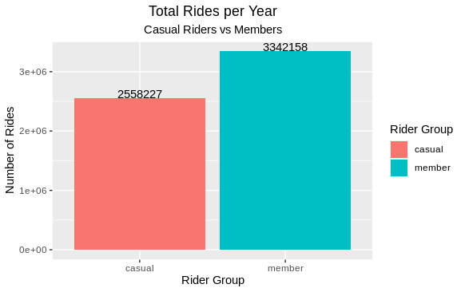
A simple comparison of total rides between the two rider groups is shown in 2021. The Total Number of Riders with Annual memberships were 30% more than Casual Riders.
Analysis and Visualization

Slide 6
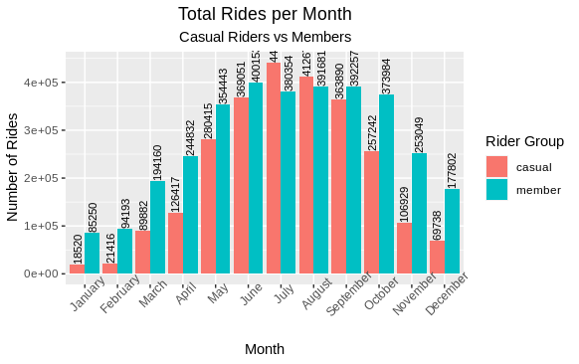
The next step in our analysis is to look at these rides at the monthly level.
Analysis and Visualization

Slide 7
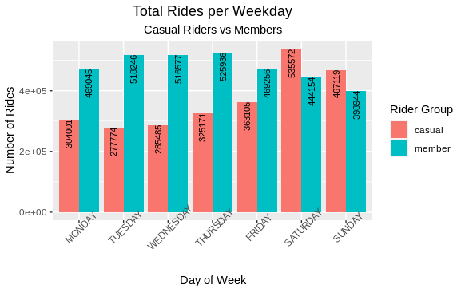
To take this analysis a step further, we will compare ride patterns on a daily level.
Analysis and Visualization

Slide 8
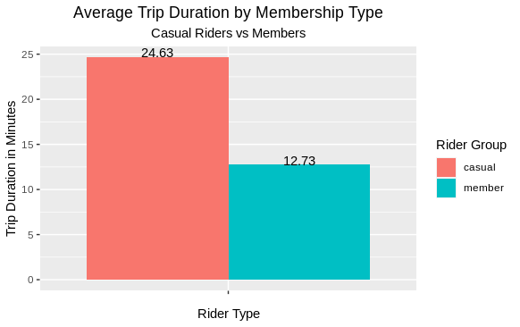
Ride duration is the next metric to compare. The plots below show that, on average, casual riders take rides over twice the duration of those that members do. This trend can be seen at a monthly and daily level, further indicating that members are taking more consistent, direct rides to and from work compared to those of casual riders.
Analysis and Visualization

Slide 9
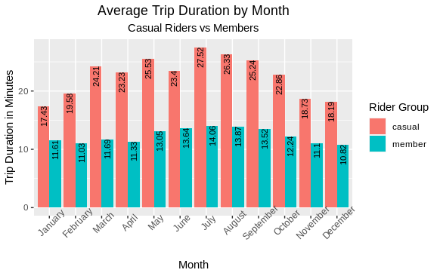
The next step in our analysis is to look at these rides at the monthly level.
Analysis and Visualization

Slide 10
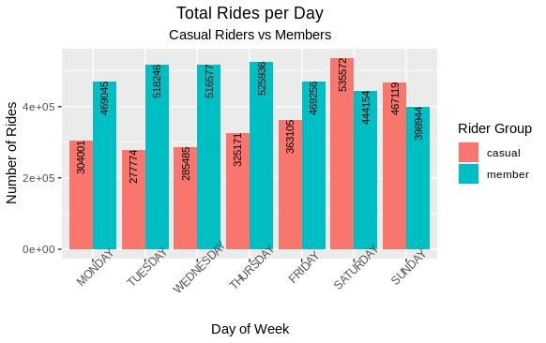
The next step in our analysis is to look at these rides at Everyday level.
Analysis and Visualization

Slide 11
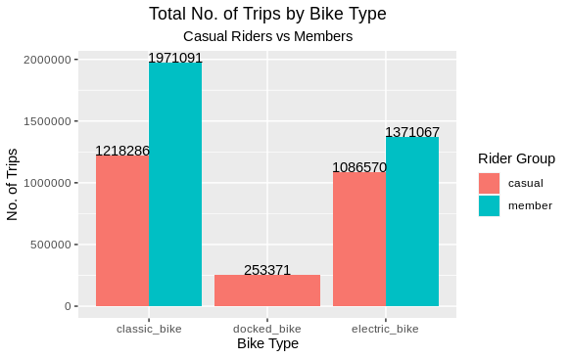
The next step in our analysis is to look at these rides on Type of Bike.
Analysis and Visualization

Slide 12
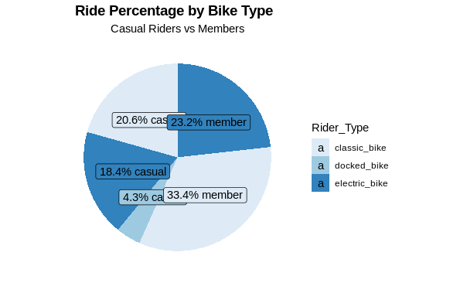
The next step in our analysis is to look at these rides on Type of Bike.
Analysis and Visualization

Slide 13
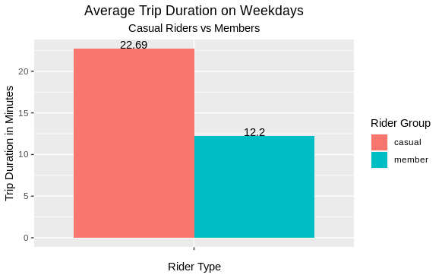
The next step in our analysis is to look at these rides on Weekdays(Mon-Fri).
Analysis and Visualization

Slide 14
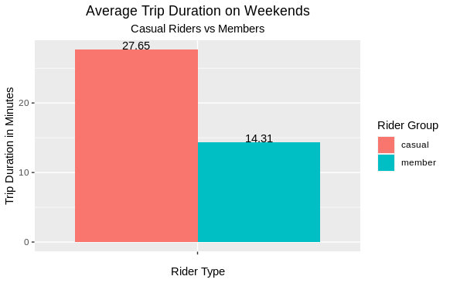
The next step in our analysis is to look at these rides on Weekends(Sat-Sun).
Analysis and Visualization

Slide 15
Conclusion
I was presented with the task of analyzing historical data to determine how casual riders and Cyclistic Members use the service differently, and offer recommendations on how to convert casual riders into Cyclistic Members. After my analysis, I can conclude the following:
Casual riders tend to take more rides as the weather becomes nicer, and take longer rides while doing so. There is also an increase in casual activity during the weekends. They also take longer rides, almost double the time of those of members. These are all indicative of a more fun, leisurely use of the services, but not a concrete explanation.
Members tend to be more consistent in using the bikes during the winter months, with an expected increase in activity as the weather becomes more tolerable. They are more active during the work week and take consistently shorter rides. This is indicative of using the bikes for more purpose-oriented rides such as work or errands, but again are not concrete explanations of their uses.

Slide 16
Moving Forward
This case study was an excellent way to not only put my skills to use, but to uncover areas of improvement. In the future, I want to be more efficient with my processes. Throughout my analysis, I frequently found myself knowing what I wanted to do, but ran into roadblocks in the actual implementation of said actions.
This was typically overcome through (google) research or trial and error. Additionally, I would like to make use of other platforms than just RStudio such as SQL and Tableau. Overall, I feel that this was a great learning experience and look forward to growing as an analyst.

